Slide 1
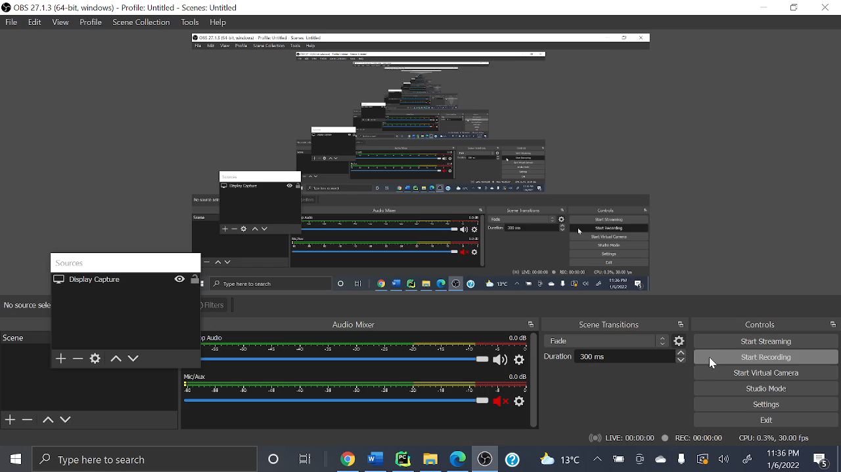
Careful, prediction in app starts from 0, in python CID starts from 1, so there is no error

